Slide 1
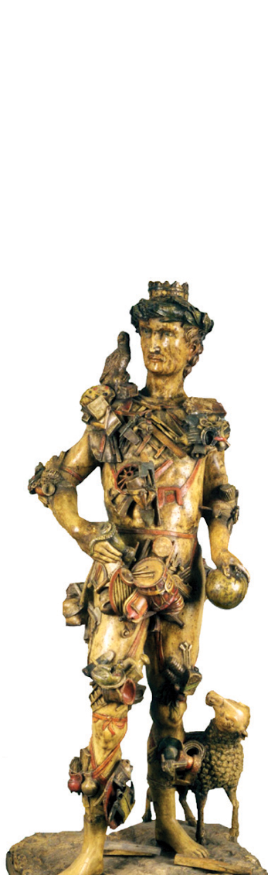
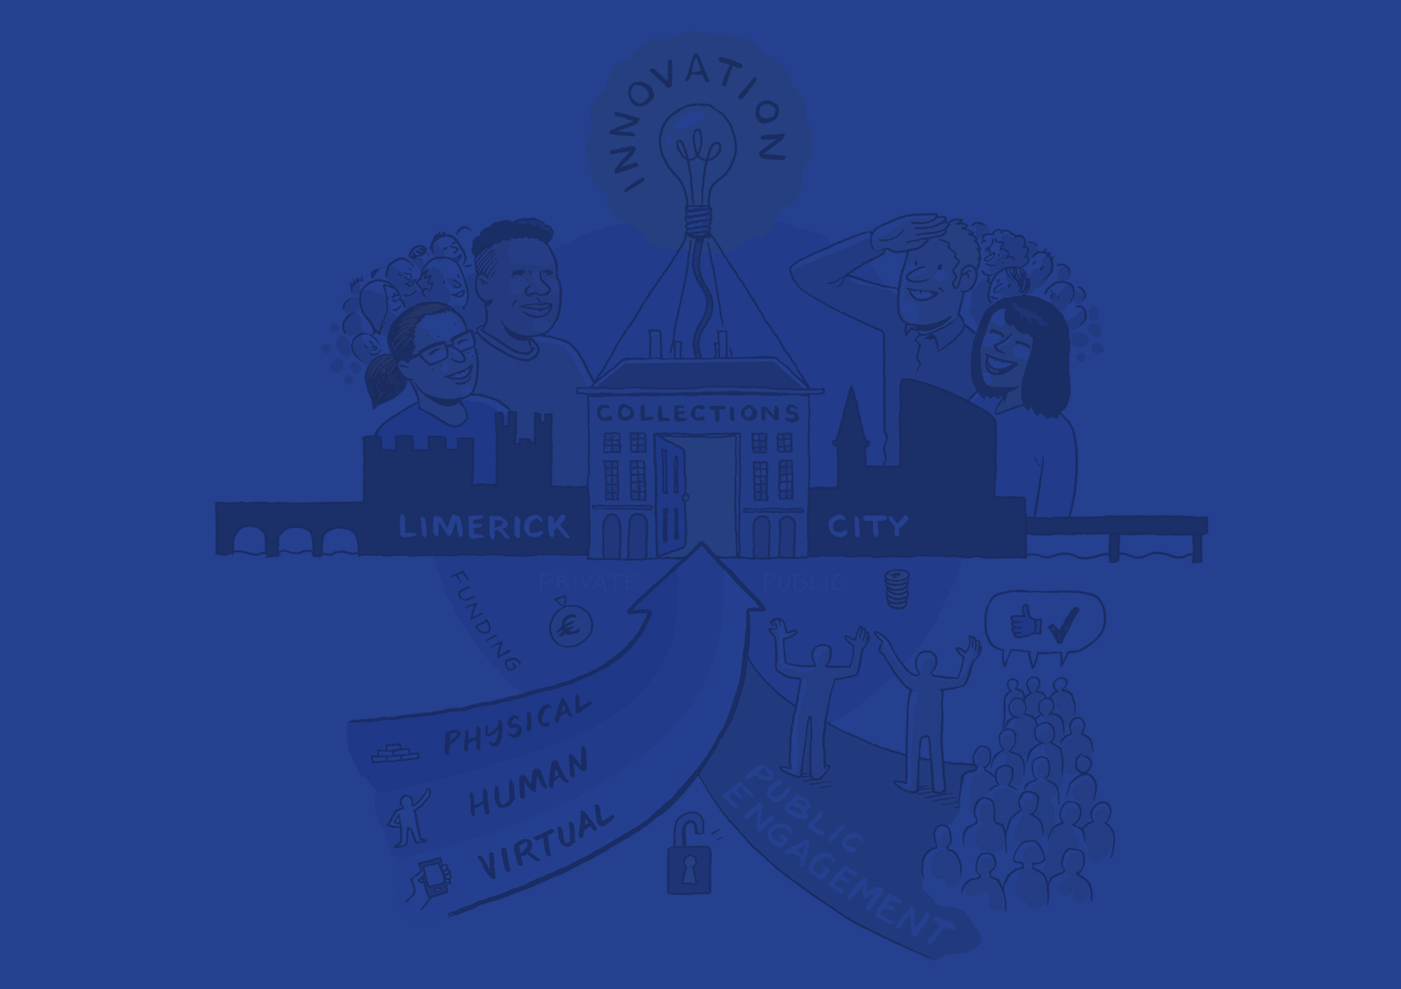

Hunt Museum Annual Report 2020
Changing Lives with Culture, Creativity and Learning
Notes:
Very proud that the team of colleagues, our docents and the Friends of the Hunt Museum still managed to achieve over 75% of the Key Performance Inditactors we had set ourselves at the end of 2019 for 2020

Slide 2
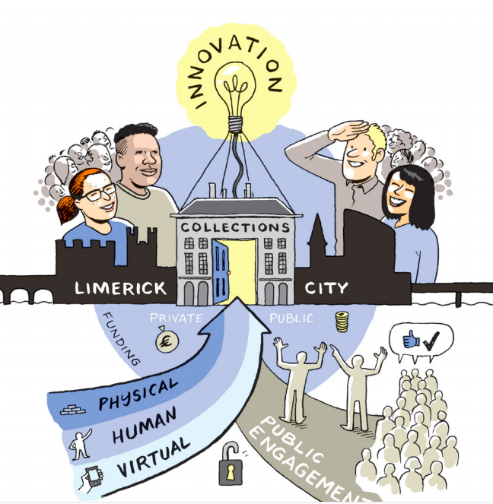
2020 Overview
Despite Covid 19 and two periods of closure from March to July, and October to December - The Hunt Museum was able to pivot its activities to online and achieve 75-80% of the KPI’s set out in our 2020 Business Plan
Notes:
Our Business Plan links to the Hunt Museum Strategy 2025, created at the end of 2018 this is now the second annual plan that works to achieve the goals of the Strategy
We have 4 priorities which are supported in collaboration with local partners LCCC, LMHA at other s and internationally through projects scuh as Europeana Archaeology and Europe @ Work.
The priorities rely very much on our willing and able communities of Docents, and Friends.

Slide 3
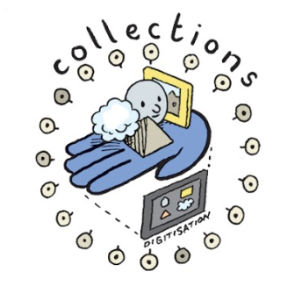
Priority 1 Collections
Collections performed very well in 2020
achieving all 4 objectives, with a slight
shortfall on 3D digitisation of
archaeological objects.
Notes:
First Priority is Collections

Slide 4
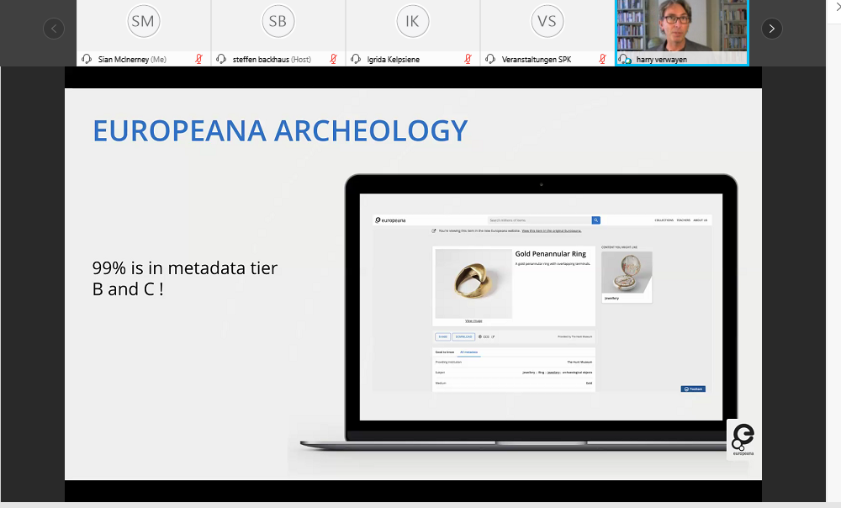
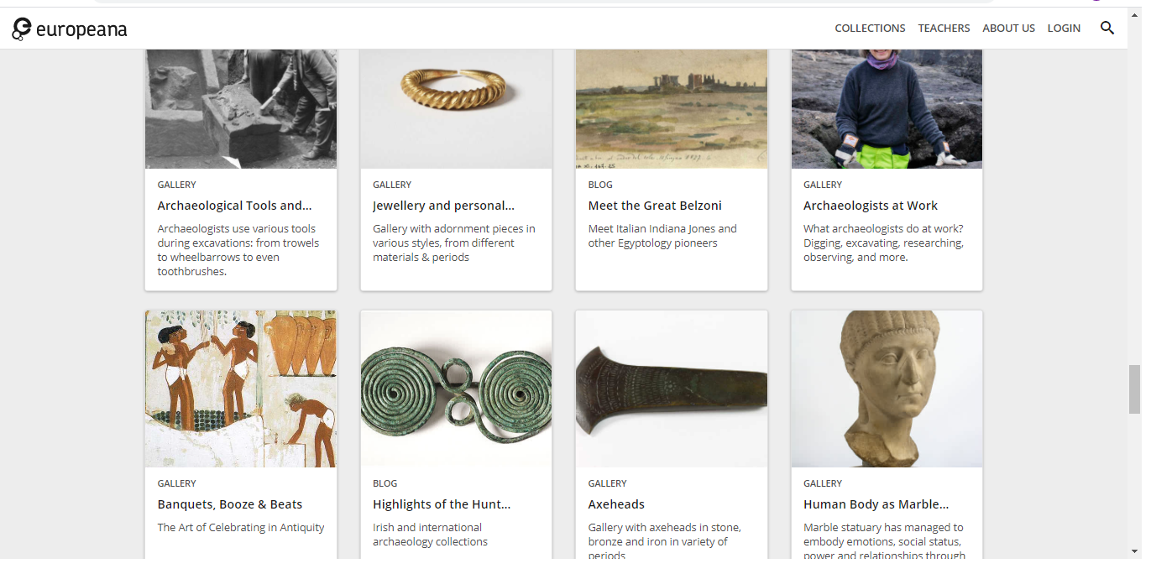
Priority 1: Collections : Objective 1 & 2
Collection Digitisation:
100 more (baseline end 2019) objects rendered as 2D & 3D Digitizations
Collection Management System
Large percentage of object records on new Content Management System with 500 meeting the Europeana Tier 3 quality target
Above: Objects added to Europeana in 2020.
Notes:
With its digitisation programme and the starting of a Collection Managemetn Sysemt that will feed our website, display and future online work. We also managed some very essential work on the metadata that describes the objects in our collections. With the Front of House staff willingly retraining to do the data entry. This means that now our objects can be retrieved via the search engines and on our own website.
It also meant that we could meet the quality targets of Europeana and WikiCommons for the publication of data.

Slide 5
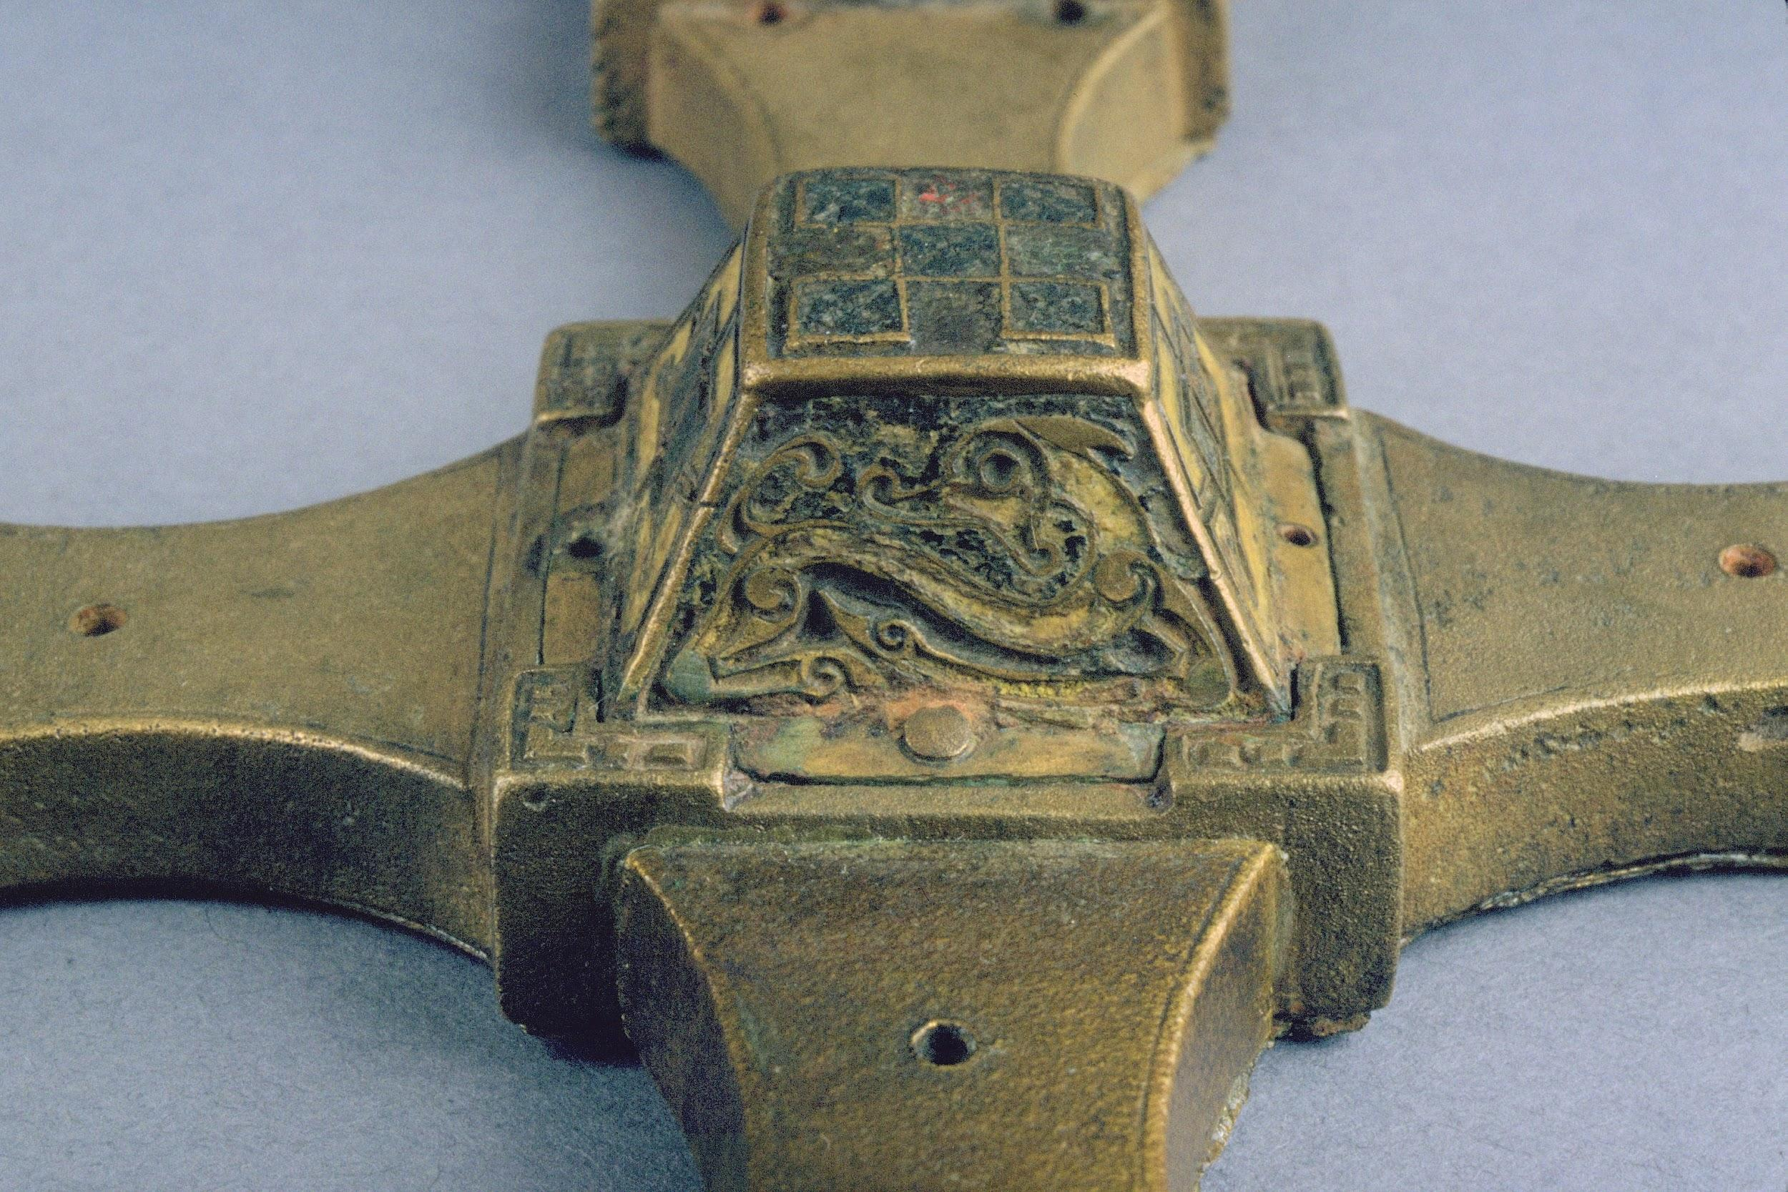
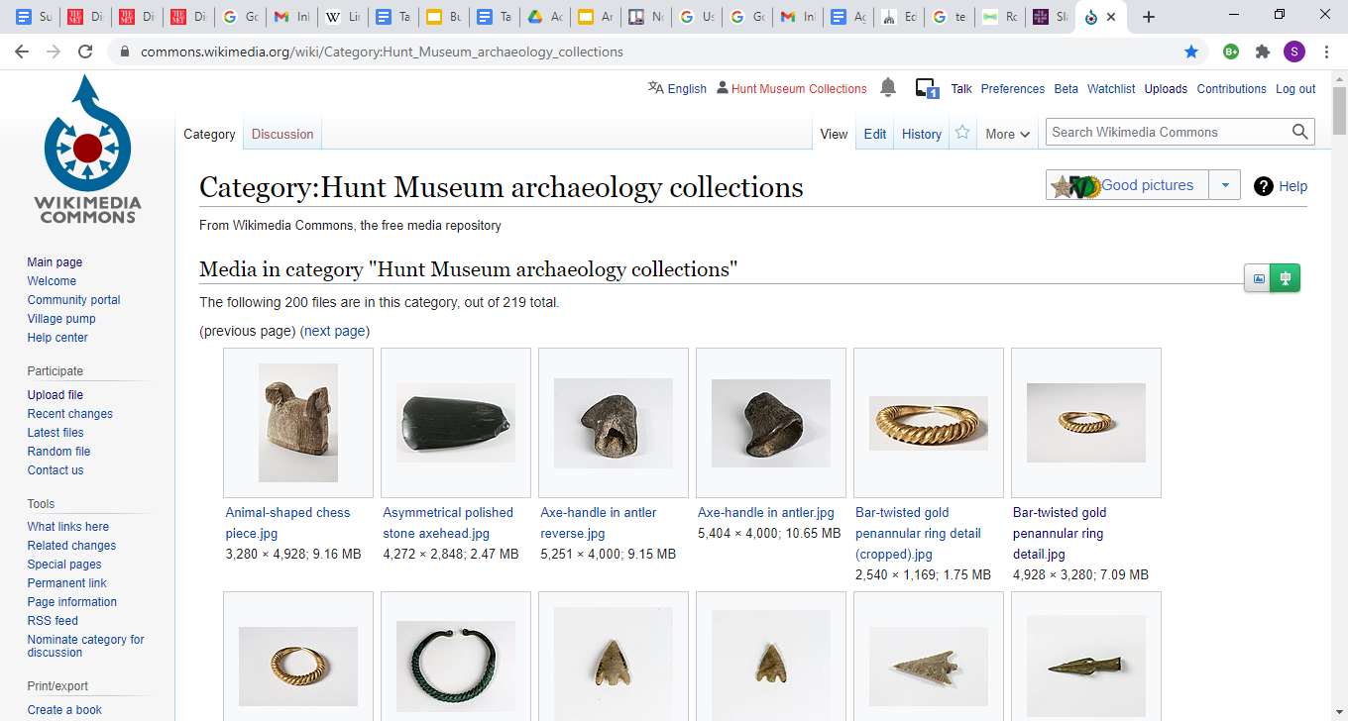
Priority 1: Collections : Objective 3 & 4
3. Collection Outreach
156 objects uploaded to WikiCommons & Europeana
Curated an archaeology gallery in Europeana
4. Display modernised
The ambition to have one study room redesigned with digital displays and heavily reduced number of objects on display was not realised due to closure but renewed efforts were put into VR and AI investigation.
Left: Antrim Cross | C9th |Cast Bronze | Hunt Museum | Public Domain -
New European Project
Art of Reading in the Middle Ages €80K
Right: Images of objects added to WikiCommons s in 2020.
Notes:
Out images and data is now discoverable on their platforms, increasing the reach of our museums artefacts by everyone across the world.
We still need to update our displays but this is just delayed not deferred.

Slide 6
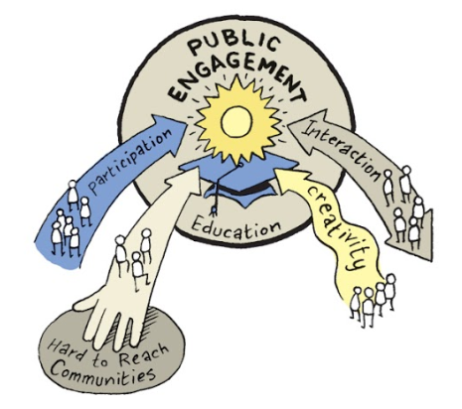
Priority 2 Public Engagement: Visitors
Public Engagement : Visitors significantly affected by COVID-19 with a massive reduction in visitors to the museum from norm of 120,000 p.a to 32,000 in 2020. However website traffic increased to 56,000 visitors (page views nearly 200,000). Social media saw a 109% increase
Notes:
Our Second Prioirty is Public Engagment - covering visitors, education, Community and Participation
Here the work that we had done on digitisting the collections over the previous 2 years paid off and our ability to be a first mover when Covid 19 hit and we had to close our physical building became very apparent.

Slide 7
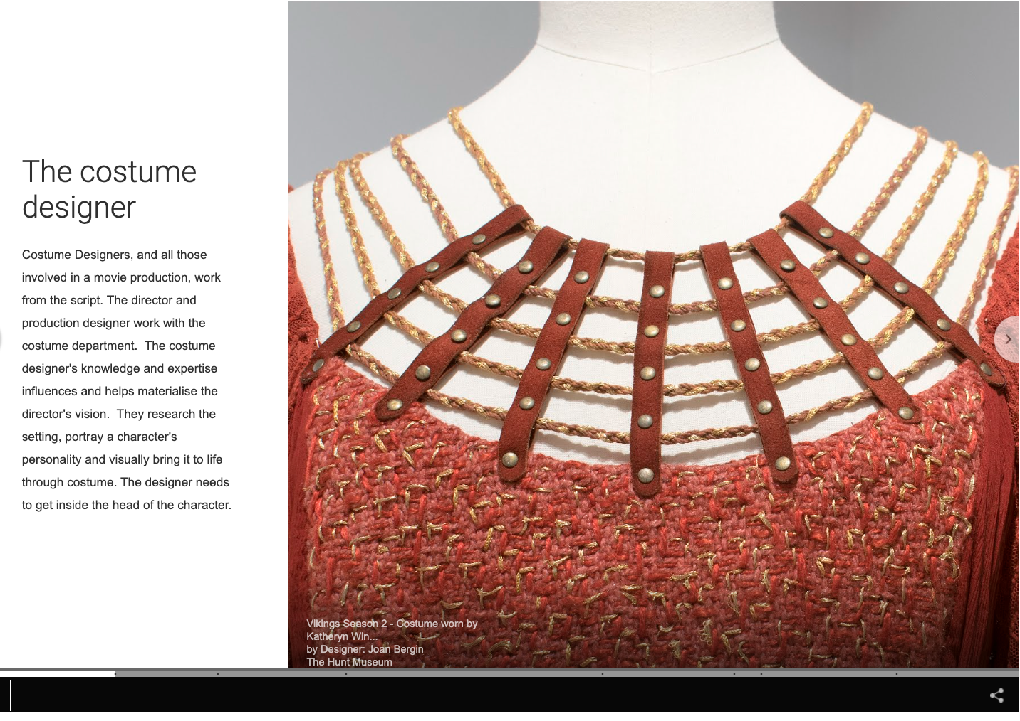
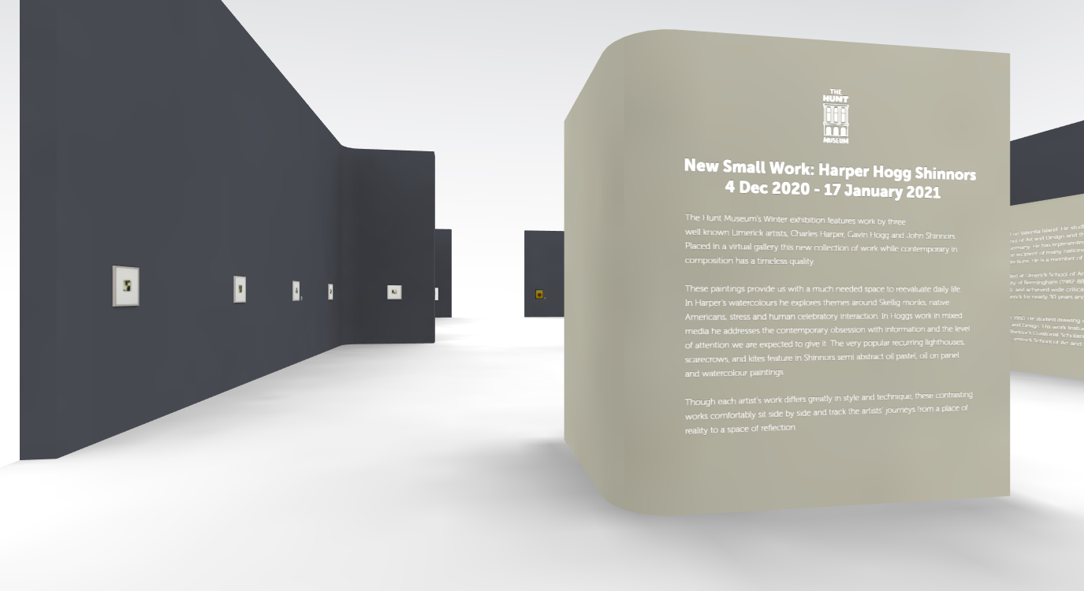
Priority 2 Public Engagement Visitors: Objective 1 & 2
The exhibition programme to increase visitors by 5% on 2019 was not met due to COVID-19
2. Reached a global audience with two new online exhibitions:
Best Costume Goes To…
  Online: 611 pageviews / 470 unique pageviews
Virtual Exhibition for Harper Hogg Shinnors
  731 pageviews / 555 unique pageviews
Above: Best Costume Goes to…Online .Exhibition
Below: Virtual Exhibition Harper Hoggs Shinnors.
Notes:
We created 2 new virtual exhibitions: Entwined in the Fabric linked to Best Costume Goes to… on the Googel Arts and Culture Platform and a actual virtual exhibition space for our annual living artists exhibitio New Small Work form Harper, Hogg and Shinnors

Slide 8


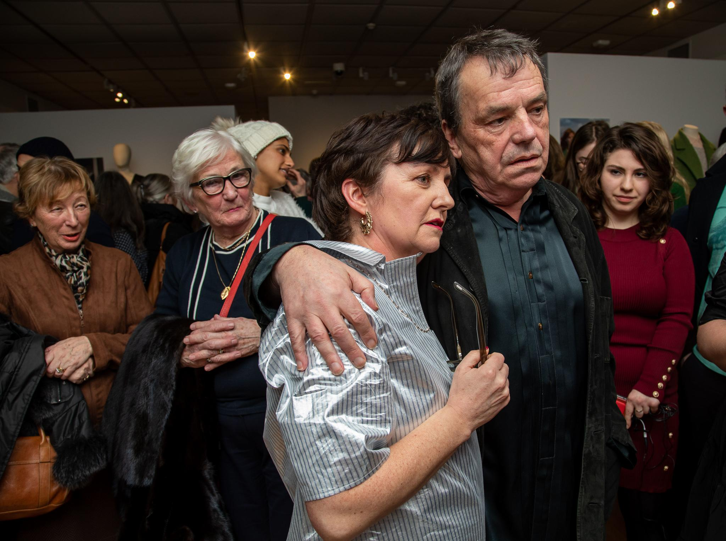
Priority 2 Public Engagement: Objective 1 & 2
When the museum was open, BCGT received…
Visitor numbers
Feb - July 1465
Aug - October 960
Engagement on social platform:
10,000 followers on Twitter in late October
57% increase in website traffic on our 2019 numbers and a 109% growth across our social media platforms.
New Small Work - Harper, Hogg and Shinnors experimented with a virtual exhibition.
Left: Best Costume Goes To… Neil Jordan at the launch of the exhibition.
Notes:
Overall we saw a 57% increase in our website traffic and a 109% increase on our social media channels.
Before Lock Down we had a very successful physical exhibition with Best Costume Goes to… in collaboration with the Irish Costume Archive Porject.. With costumes from films such as Breakfast on Pluto, Micahel Collins, In Bruges, The Favourite.

Slide 9
Priority 2 Public Engagement: Education
Public Engagement: Education performed very well in 2020 completing 3 out of 4 objectives.
Notes:
In the Education Area of PUblich Engagement we truly excelled with some brilliant and very innovative online offernings for schools ad parents struggling with lockdown.

Slide 10
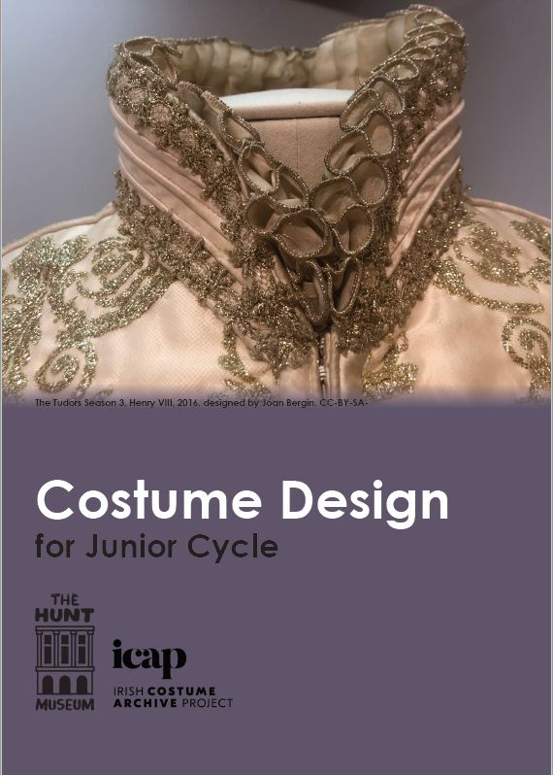
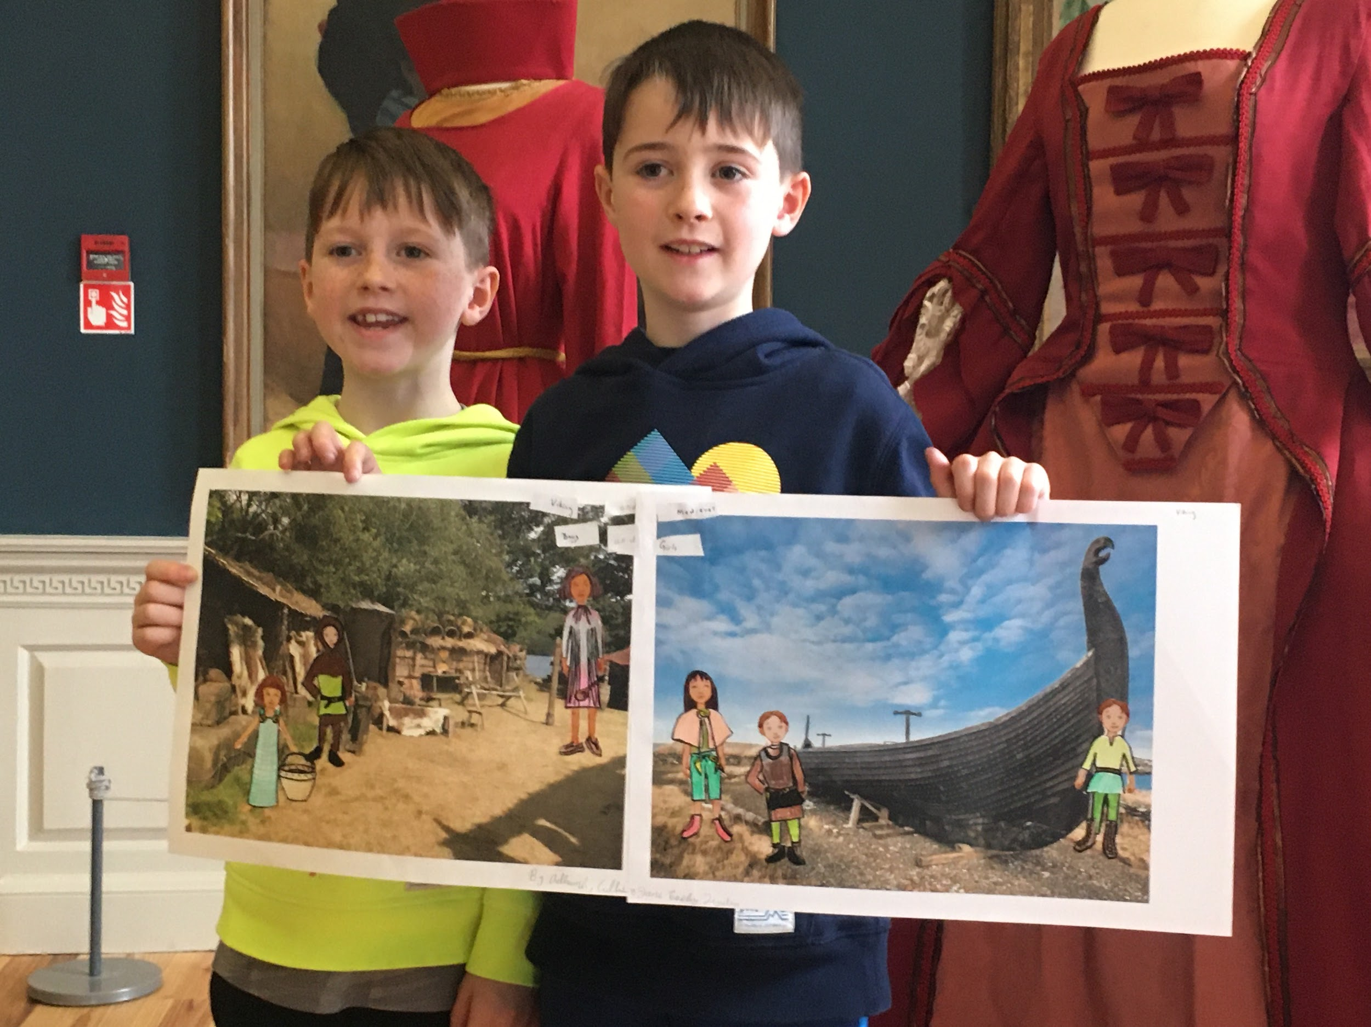
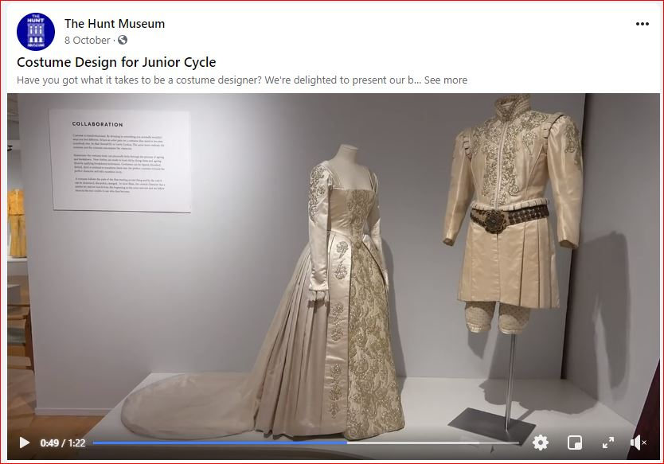
Priority 2 Public Engagement:Education
Objective 1 & 2
25% of Limerick City & County schools have used Hunt Museum digital learning resources (online for COVID-19)
  The Joint Education Pilot Project Three Muses: 63 participants from Limerick schools participated and a further 210 from outside Limerick.
Delivery of digital version of the migration game for use in the museum visitors - was not possible due to COVID-19.
Above left and below lef: Best Costume Goes To… Education Programming
Above right: Viking workshop
Notes:
From costume design to Art and Identify under our Three Muses project run in a threeway collaboration with LCGA and LCM.

Slide 11
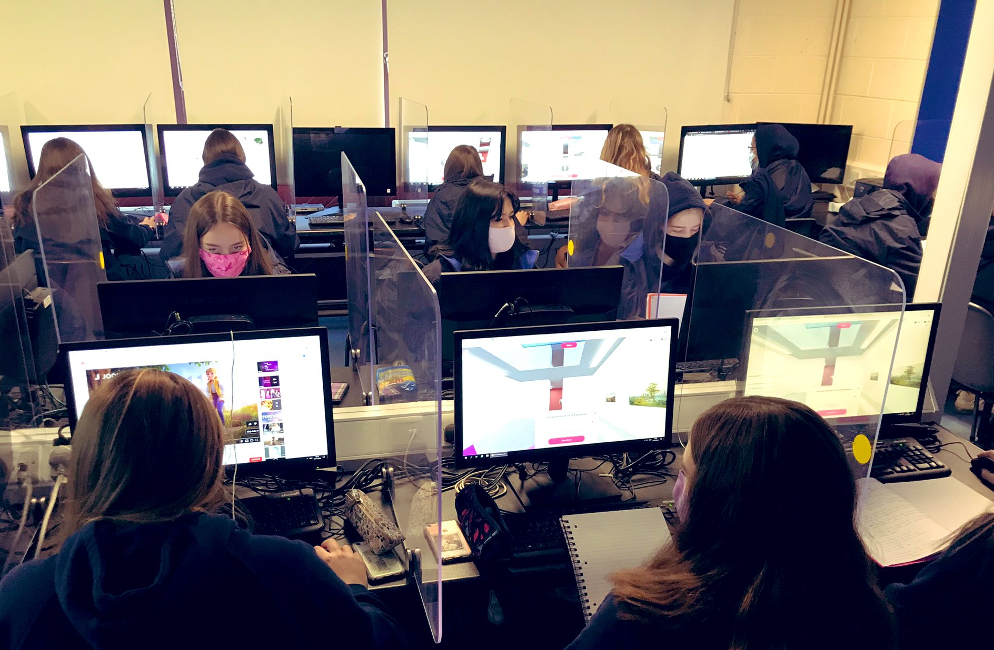
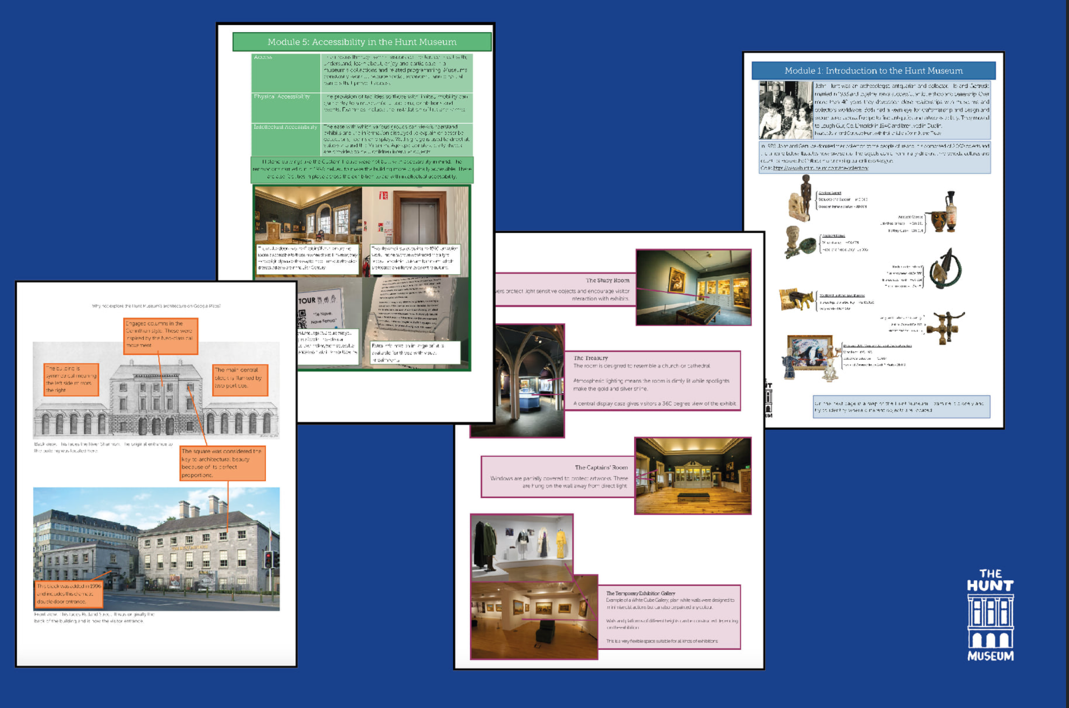
Priority 2 Public Engagement:Education
Objective 3 & 4
3. Increased collaboration with Lough Gur & Craggaunowen with 1 new archaeology loan
box & scoping of a joint STEAM programme with Craggaunowen
4. At least 3 one off workshops for schools linked to temporary exhibitions:
Video based workshops on the Vikings
Best Costume Goes to… to Junior Cycle Students
Exhibition Layout & Design online resources were delivered for Senior Cycle students in Visual Art, Craft & Design.
Left: Students partaking in the Three Muses on Mozilla Hubs using images and 3D objects from the Hunt, Limerick Museum and LCGA
Right: Developing the Exhibition Layout and Design online programme for Leaving Cert Art students
Notes:
We used Mozilla Hubs, had video basked workshops on the Vikiongs, produced an onlin exhibition layout and design product for Leaving Cert Art Students among many more

Slide 12
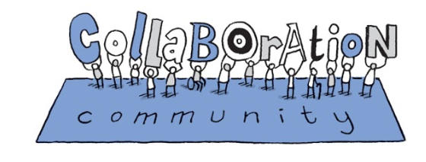
Priority 2 Public Engagement: Community
Public Engagement: Community was challenged by the COVID-19 pandemic and had to be adapted.
Notes:
On the Community Front we couldnt meet any objective that required coming together physically

Slide 13
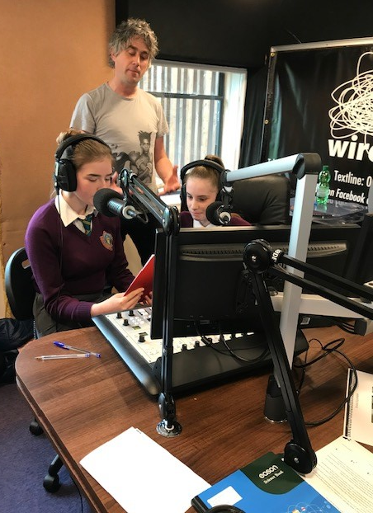
Priority 2 Public Engagement: Community
Objectives 1 & 2
Objectives could not be met:
Covid19 impacted heavily - groups couldn’t gather for the various activities and working virtually was not an option due to the need of accessing specialised equipment. Contact was kept up with all groups.
Communities of Culture (Phase IV)
TY students from Thomond College completed multimedia training with WIRED FM in Feb 2020.
Right: TY students from Thomond College completed multimedia training with WIRED FM
Notes:
but did at least complete some multimedia training with WiredFM and TY Students.

Slide 14
Priority 2 Public Engagement: Participation
Participation met 3 of 5 objectives with a particularly fantastic worldwide response to Europe @ Work Ardnacrusha Memories.
Notes:
In terms of Particiopation we had a fantastic project in

Slide 15
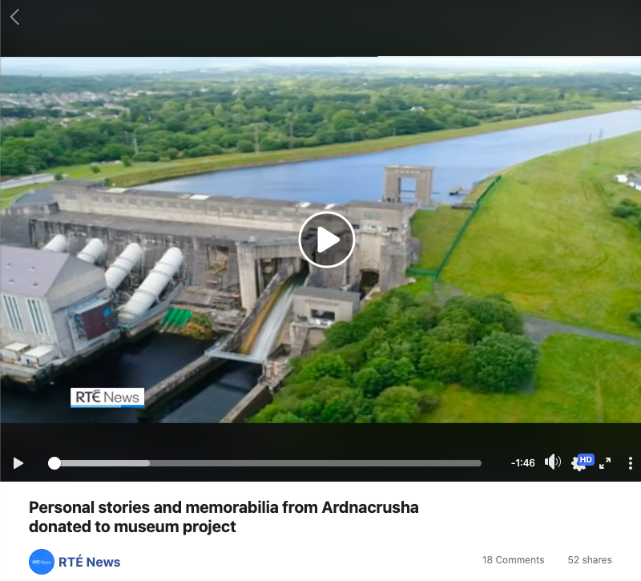
Priority 2 Public Engagement: Participation
Objectives 1 & 2.
Instead of holding 2 public editathons, an internal staff one was held to add material to WikiCommons and more effort put towards to Ardnacrusha Memories leading to significant participation from Docents interviewing older people which culminated in a Europeana Blog, a piece on RTE News and will form the basis of a new STEAM resource with Mary Immaculate College.
Digitisation of 2D and 3D objects for sharing resumed in October and the target of 100 was met.
Above: RTE News coverage of Ardnacrusha Memories Link
Notes:
Europe at Work with Ardnacrusha Memories where docents interviewed and collected memorabilia from people who had worked on the Shannob Hydro Eletirc Scheme.. Culminating in an international online and offline Symposium between lockdowns.

Slide 16
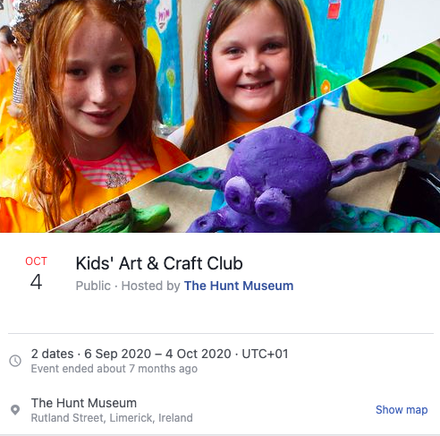
Priority 2 Public Engagement: Participation
Objectives 3, 4 & 5
3. Community Collection events - effort was switched to Ardnacrusha Memories and an fantastic symposium with some of the workers from the Shannon HydroElectric Scheme sharing their stories with academics and researchers including the ESB Archivist.
4. Dementia programme was stalled due to COVID but the Ireland Funds Grant has been carried over to 2021
5. Kids Arts and Crafts Club continued online very successfully
Above: Screenshot of Hunt Facebook page advertising Kids’ Arts & Craft Club
Notes:
And our Kids Arts and Crafts, part of hte Musuem At Home series was a lifesaver for parents an children looking for real things to do at home

Slide 17
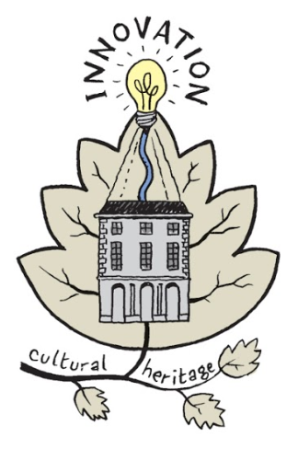
Priority 3 Innovation
Innovation completed 1 of 2 objectives due to COVID-19.
Notes:
Innovation our 3rd Priority
Gardne - competition and f

Slide 18
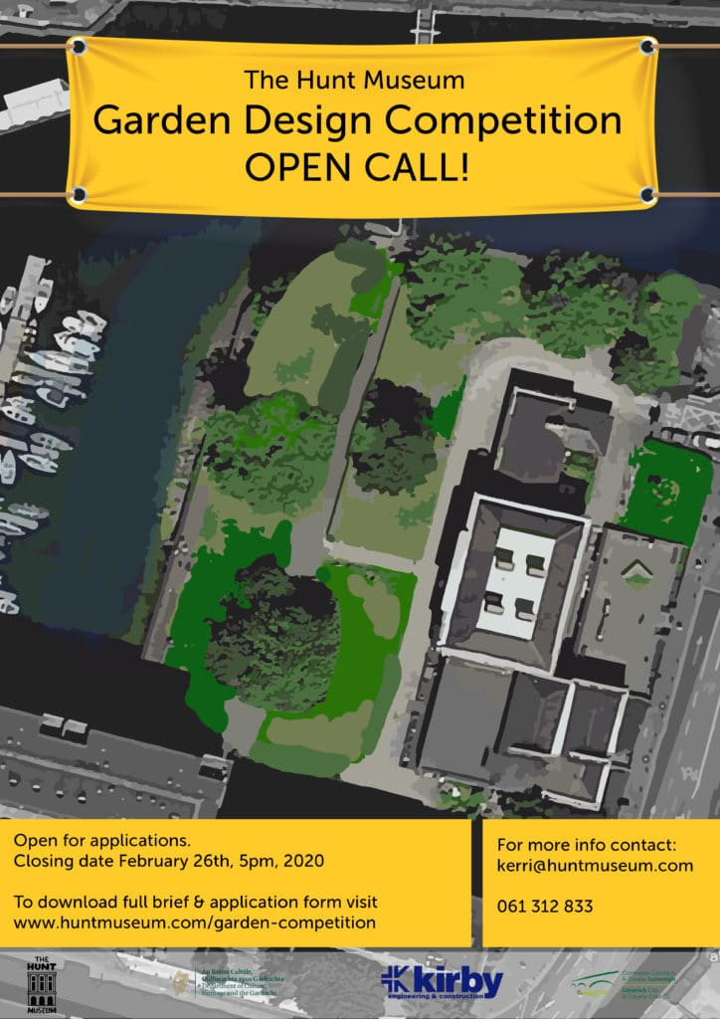
Priority 3 Innovation Objectives 1
Museum in a Garden while not completed in 2020 so missing the objective made good progress given the circumstances. A competition for a new design led to a successful and exciting appointment. A contractor was also retained. All the cobbles and benches are lined up and ready to go for a 2021 launch.
An additional grant from the ESB will allow us to create a large scale Olmec Man for launch.
Notes:
Museum in a Garden while not completed in 2020 so missing the objective made good progress given the circumstances. A competition for a new design led to a successful and exciting appointment. Nicola Haines of Haynes Tierney Architects

Slide 19

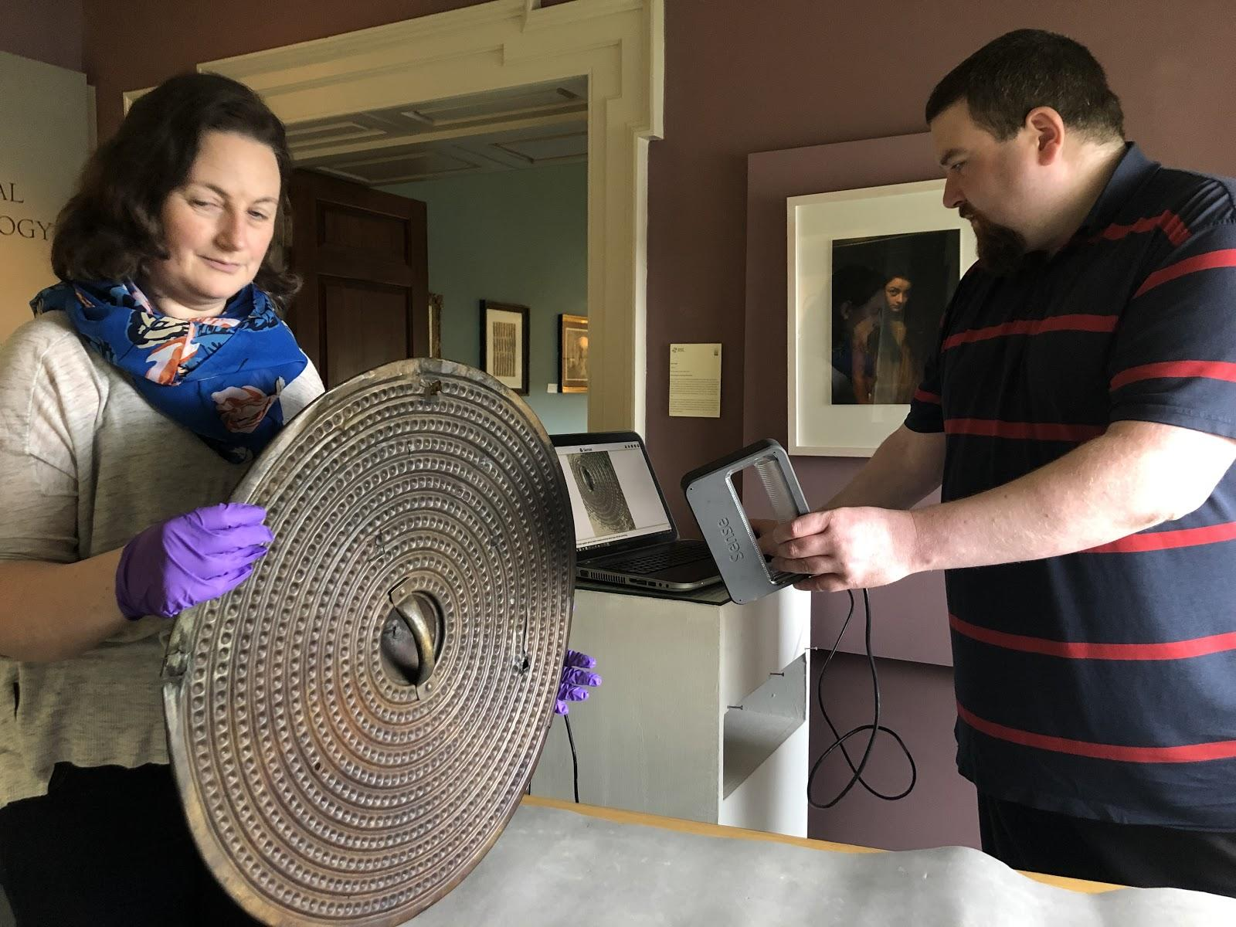
Priority 3 Innovation Objective 2
2. Limerick Museums Joint Digitisation Project
Online introductory 3D scanner training was delivered with 6 volunteers and one member of staff on Dec 3rd and 4th.
Above: More of the collection being digitised in 2 & 3D
Notes:
3D Digitisation…

Slide 20
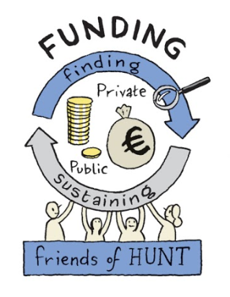
Priority 4 Funding
Funding met 1 of the 2 targets set for 2020.
Notes:
Fourth priority Innovation Funding met 1 of its 2 targets

Slide 21



Priority 4 Funding Objectives 1, 2 & 3
Grant funding target was met with €122,000 from EU and Irish Grants. Meeting the set target
Fund a Cobble was hugely successful Crowdfunding €38,000 for Garden - This amount was matched by 50,000 from the JP McManus Foundation.
ESB Energy for Generations award of €8,000 was received to create a supersize version of Olmec Man with TY Students, Arup, LIT-LSAD and UL
Corporate Membership - Benefits not being accessible while te museum was closed made membership difficult to sell. -
Sponsorship was equally hard to come by but some success was enjoyed with the Joint Education Three Muses Programme.
260K is raised from additional non-operational EU & Irish grants (€120K) , foundations and sponsors (€140K)
Three Muses was sponsored by:
Notes:
Including help from an ESB Grant and in Kind work from Arup to create what became Olmec Man and our highly successful

Slide 22
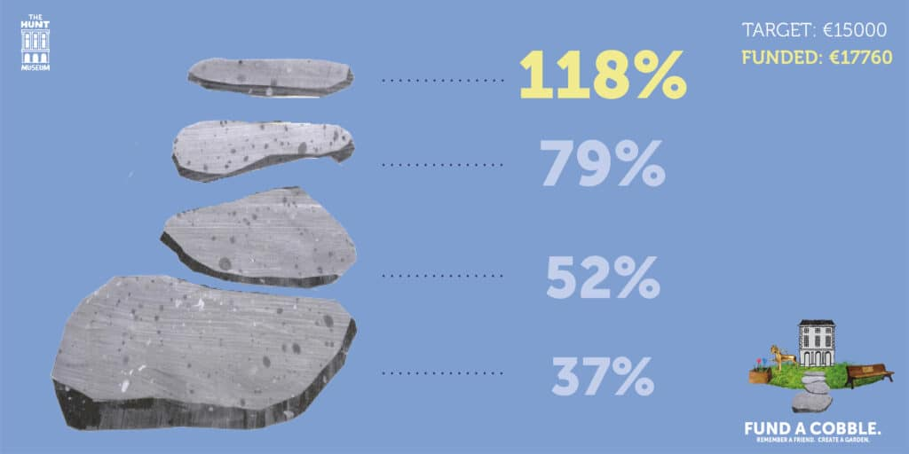
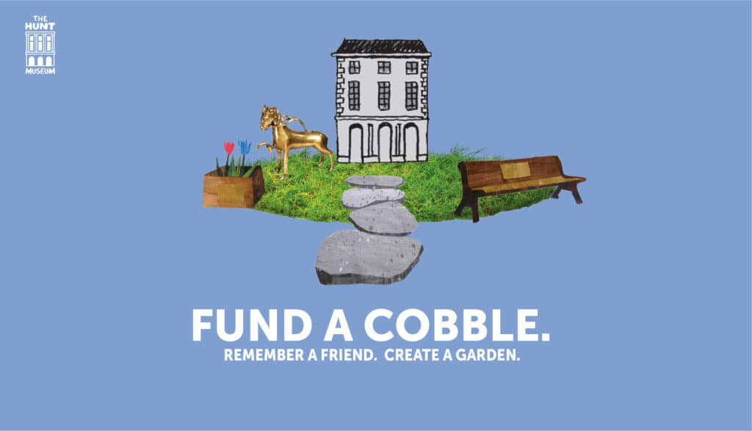
Museum in the Garden
Fund a Cobble Crowdfunding Campaign which raised €17,760
All the cobbles are lined up for it to be put into place as soon as possible in 2021
Notes:
Fund a Cobble cmapign raising directly 17,760 which with added donations became 38K then matched by a further 50K from JP McManus Foundation.

Slide 23
Priority 4 Funding - Retail
Funding: Retail suffered during 2020 with the closure of the museum.
Notes:
Retail did not do so wel

Slide 24
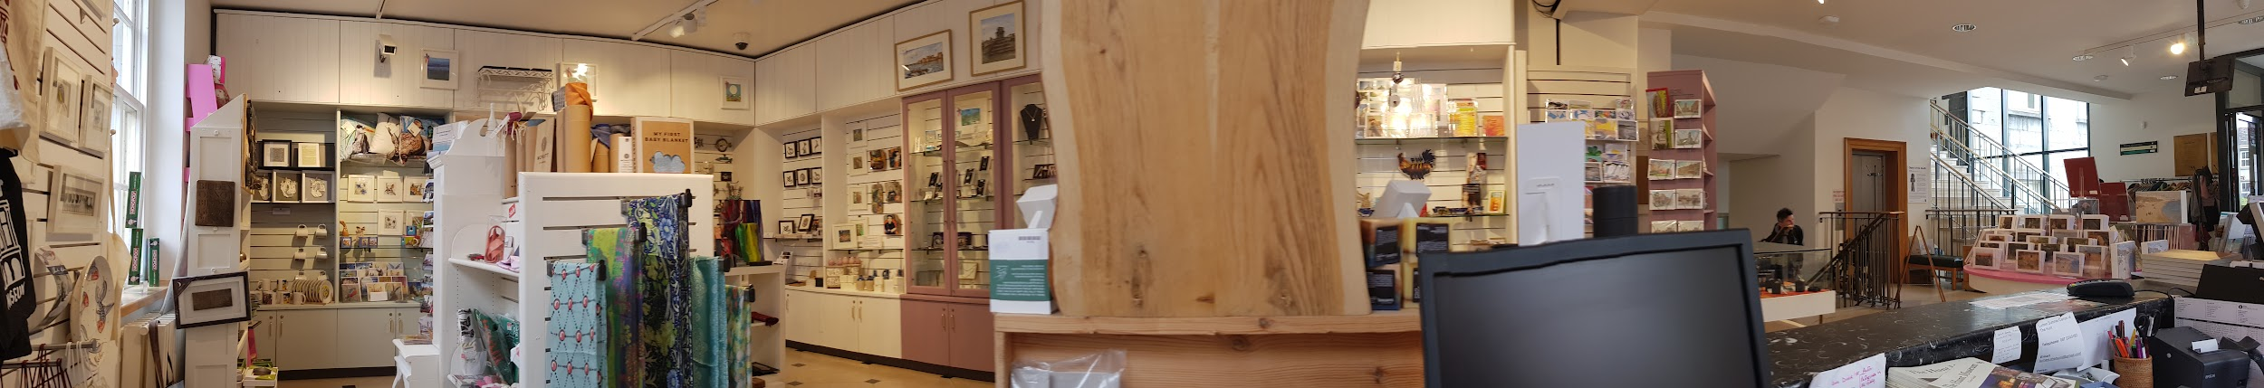
Priority 4 Funding - Retail Objective 1
Retail did very badly in the year.
  Sales did not really pick up over the summer period.
  The idea to launch a Facebook shop in time for Xmas had to be shelved as fulfilment was impossible.
  A complete rethink of retail will be undertaken in 2021.
Gift Shop display, Hunt Museum, 2019, CC-BY-SA
Notes:
l and showed the need for an online presence that could be fulfilled.

Slide 25
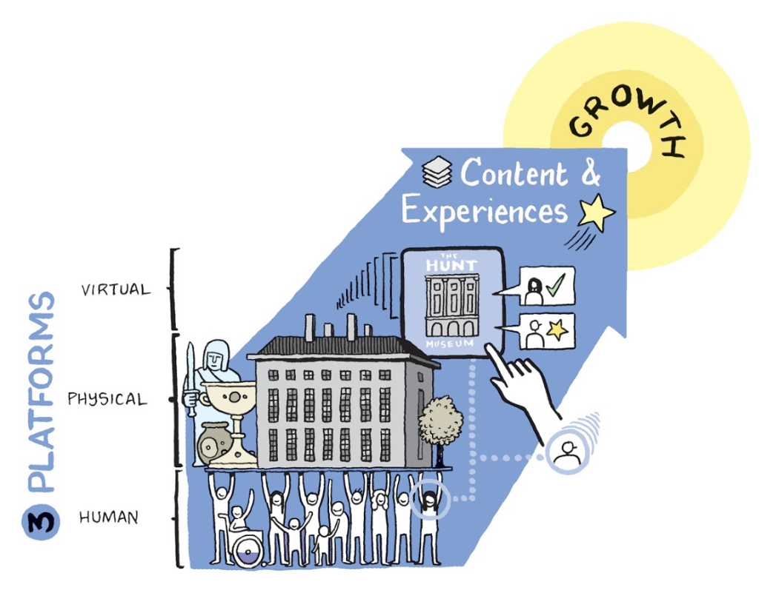
Priority 5 Marcomms
Marcomms more than met their objectives for 2020 and continued to grow our virtual audience. #MuseumFromHome was particularly successful.
Notes:
The support from hte Marcomms team was superb.

Slide 26
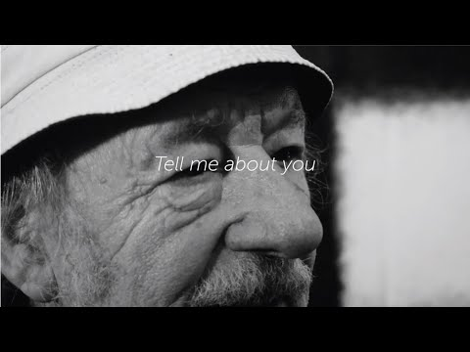
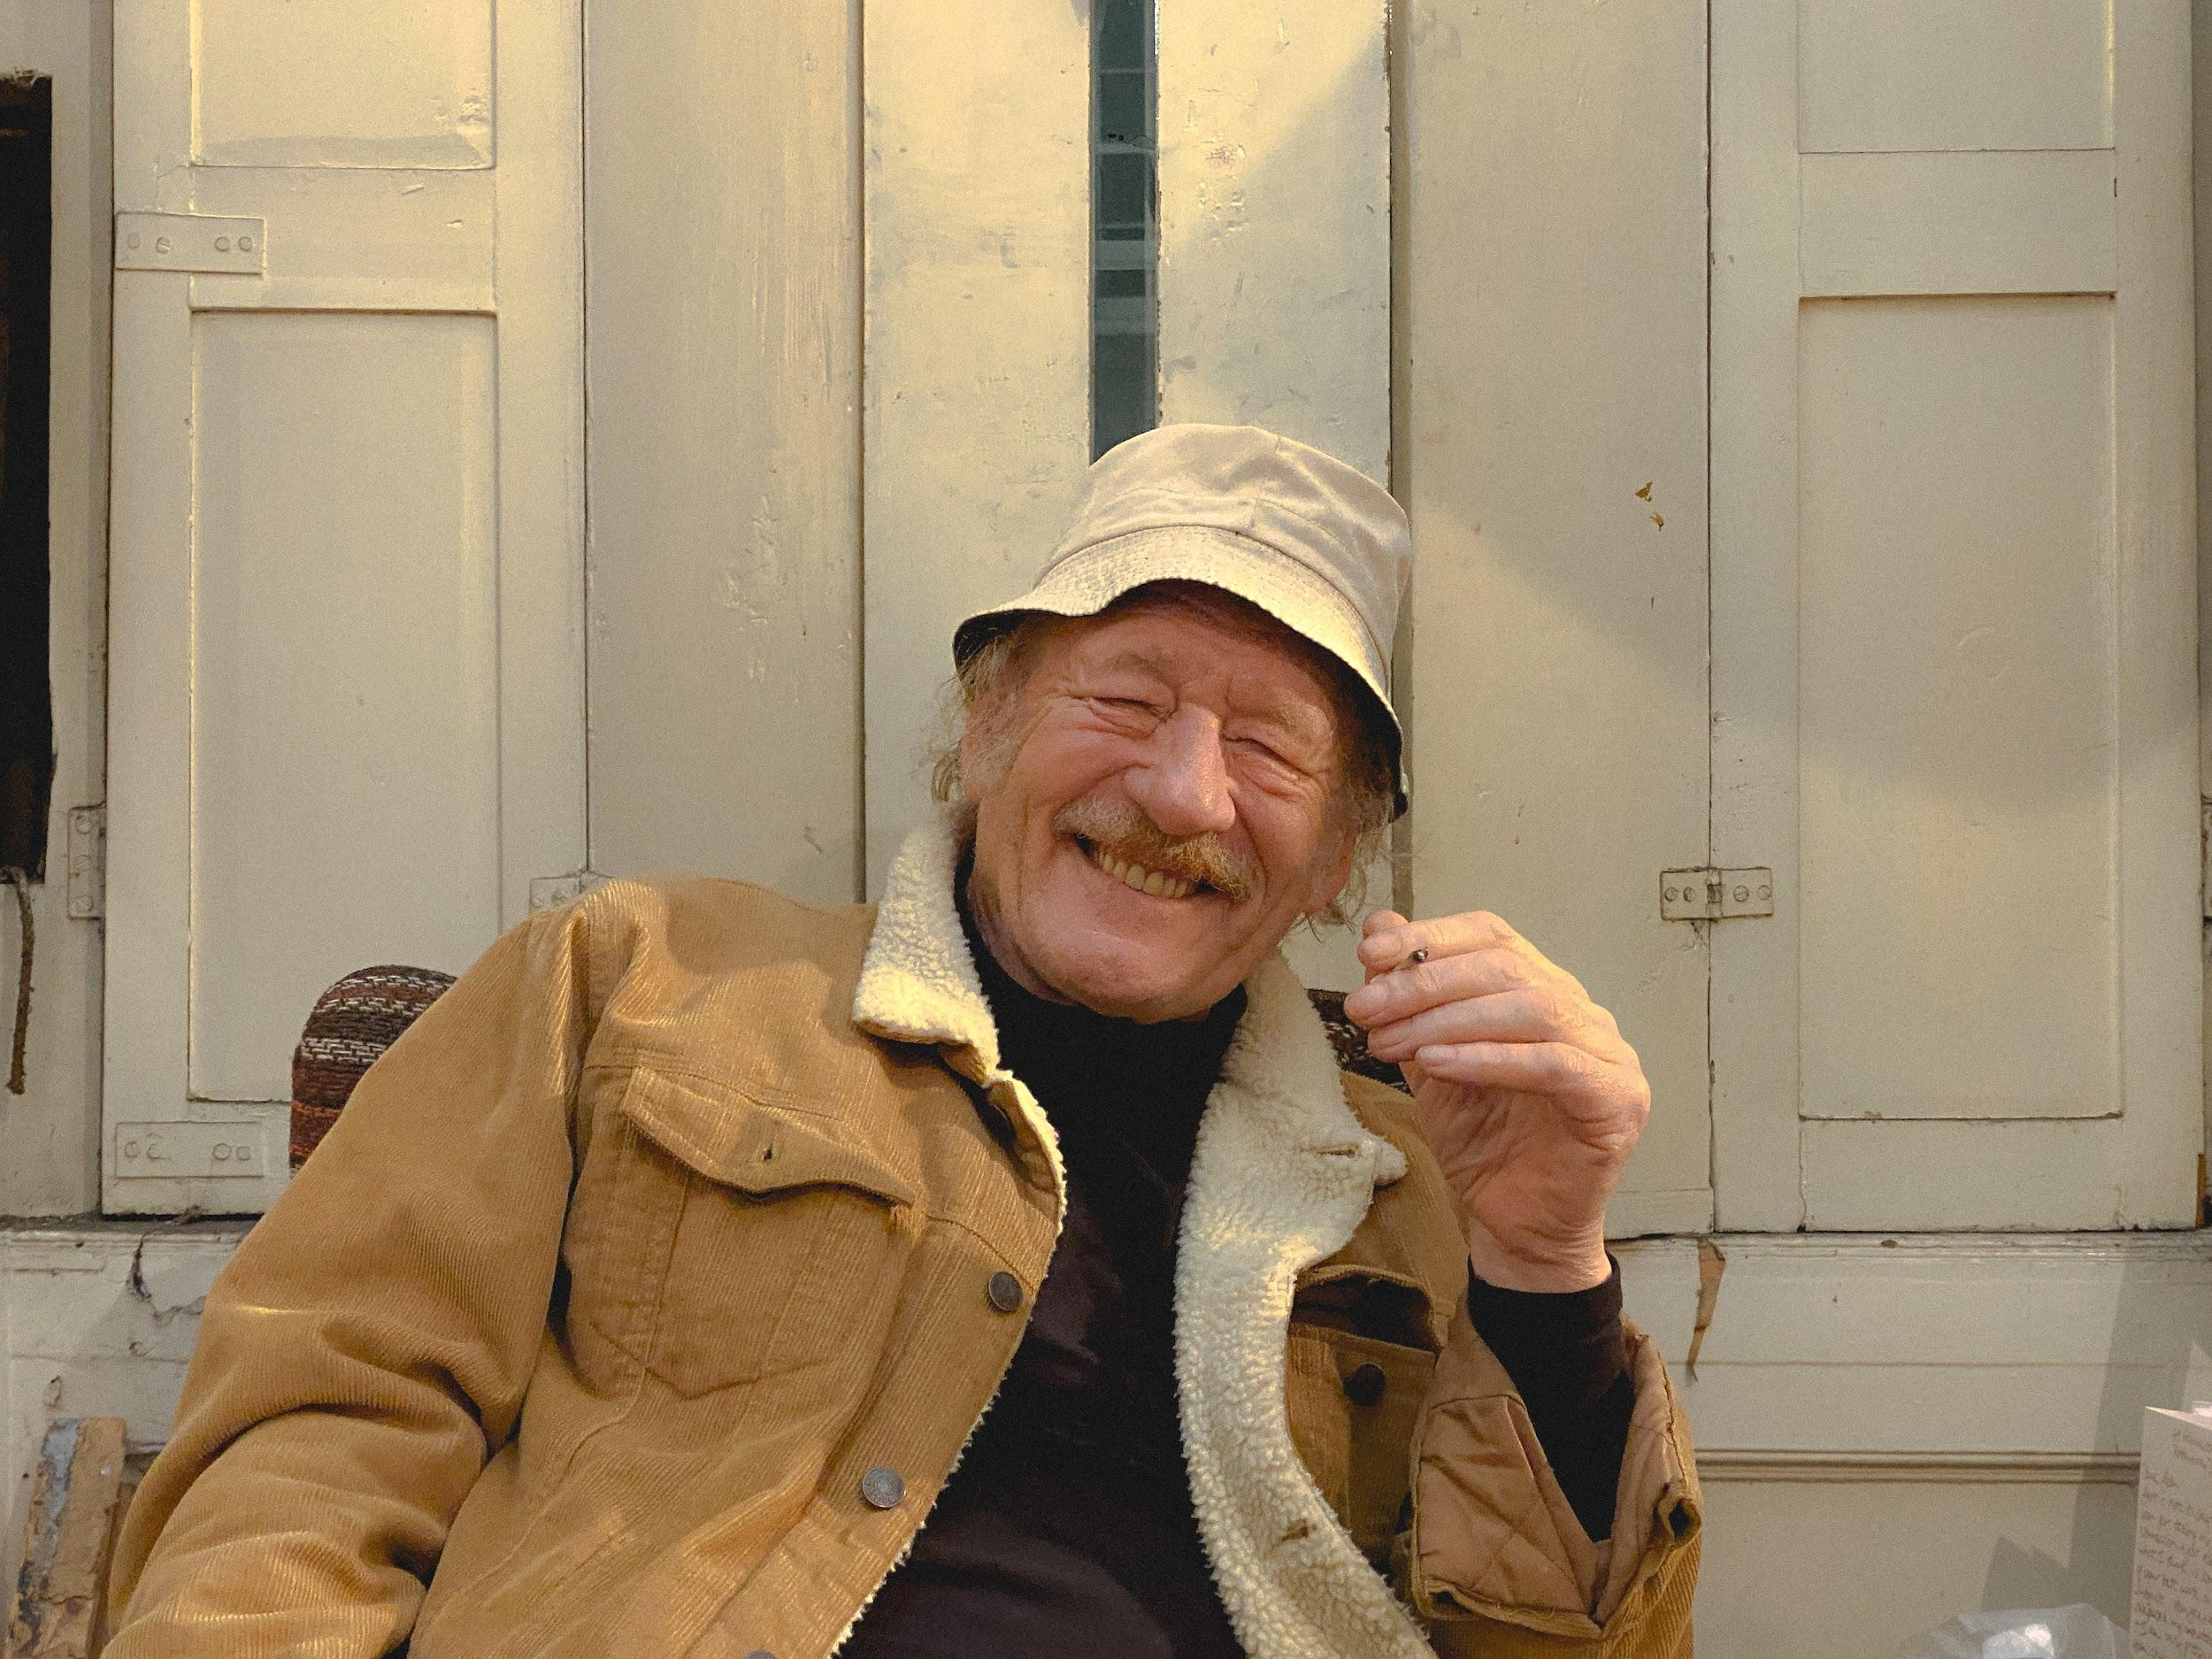
Priority 5 Marcomms Objectives 1, 2 & 3
Marketing Management Master Plan was created with all Projects, Exhibitions and Marketing Activities
Website traffic increase of 15% on 2019 was achieved
  57.73% Website traffic
  56.08% Unique pageviews
  64.34% New users
  64.97% sessions
Social Media platforms to show 30% increase on 2019 was busted!
  Social media platforms combined have shown an overall growth of 109,93% - 12.99% on Twitter, 8.9% on Facebook, and 88.04% on Instagram
Above: John Shinnors at his studio recording audios and videos For Harper Hogg Shinnors video series.
Notes:
Reflected in the quality of video and imagery as well as the social media increases.

Slide 27

Docents
Docents met their objectives for 2020 and maintained and grew our programme.
Notes:
Two groups are the backbone of the museum activities and operation. The Docents and the Friends.

Slide 28
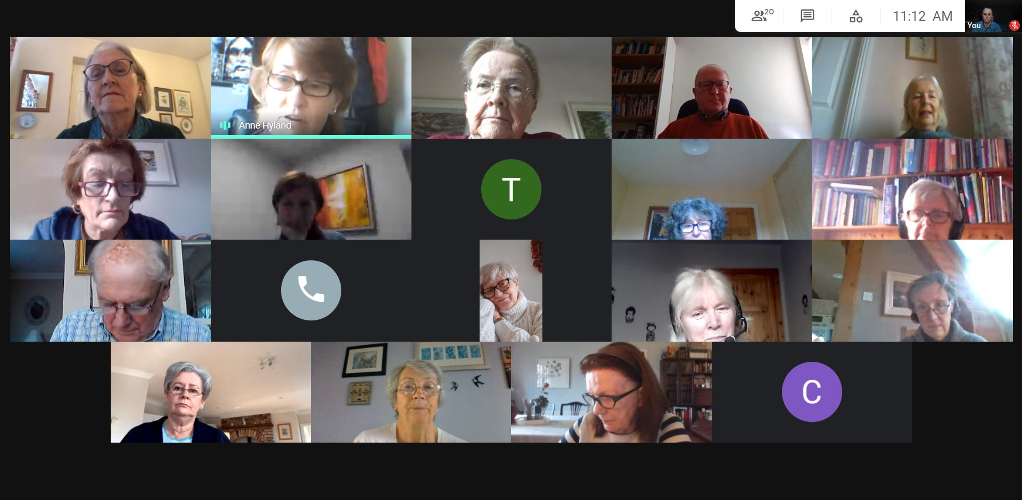
Docents Objectives 1, 2, 3 & 4
Delivery of 5 Docent projects - was difficult as they were museum based but Docents worked on #ArdnacrushaMemories
An active training and mentoring programme - Coffee morning, Lectures and Art appreciation films migrated very successfully online with including many being helped to overcome fears of technology!
Optimise benefits of being a docent - new members joined despite lockdown
4.
Nurturing of the docent group continued with much online interaction and efforts of staff with Docents remaining very involved in the museum.
Above: Docent coffee mornings on Zoom.
Notes:
As well as Archcrausha interviewing and actually doig a massive social service engaging people suffering social isolation duinr Covid There was an acitve training programme and total eingagement form these volunteers.

Slide 29

Friends
Friends objectives for 2020 suffered due to the pandemic but adaptations were made.
Notes:
Friends

Slide 30
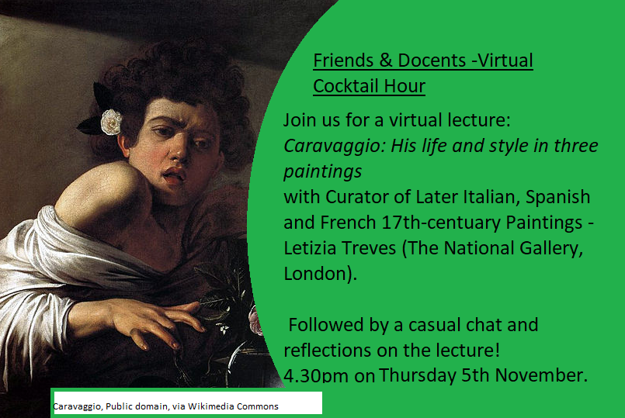
Friends Objectives 1, 2 & 3
Renewals from existing friends have been slow. Thanks go to Robert Williams, who had been an excellent Chair for two years. Our new Chair Anne Hyland, who is also a Docent, has embraced the role and is working to come up with new activities to attract membership which continued to decline over 2020.
Fundraising was very difficult as Fundraising lunch and Christmas Raffle were unable to go ahead
Several online events were run with Friends also participating in the Online Exhibition Launch of New Small Work
Friends event
Above: Example of virtual content online during closure and continued over the summer such as ‘Cocktails Hour’ - where friends & docents came together for video calls to watch informative lectures & gallery tours.
Notes:
supported the online events and made great efforts to improve membership rates.

Slide 31
Events
Events met one of two objectives for 2020 - museum closure meant a refocus of events to online
Notes:
Despite being closed we increased

Slide 32
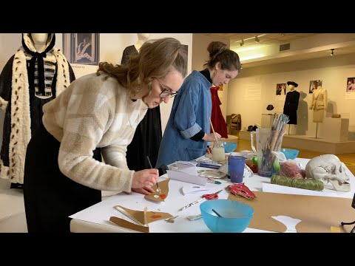
Priority Events Objectives 1 & 2
Museum closed throughout March to July & October to December of 2020.
Focused on online events using social media, our website and Zoom.
Increased number of online events - Halloween & Christmas workshops & exhibition launch all online and well attended.
Above: Video from one of the Halloween event, ‘Halloween Mask Event.’
Notes:
our online events linked to museum such as BCGT - the creation of Halloween Masks

Slide 33
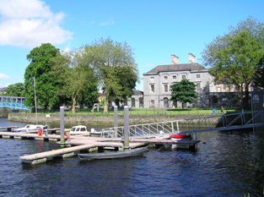
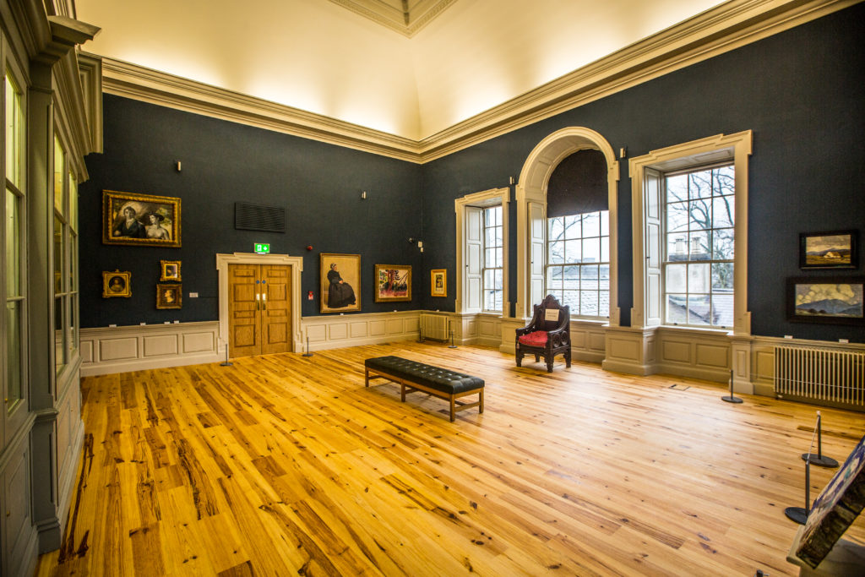
The Building Objectives 1 & 2
Five Year Maintenance plan was developed, with designated work for 2020 assigned
- Work was completed in the Education Wing which had mould growing due to damp ingress, plaster removed from all outer wall
- a new lift was installed
Drawing up of feasible architectural plans to reconfigure the building was not launched and has been deferred to 2021
Notes:
ON the building front we
5 year
Reconfigure deferred

Slide 34
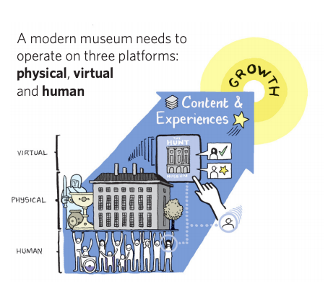
Looking forward to 2021 and the targets for our Three Platforms
Notes:
.. physical
Virtual
Human platforms
And in 2021 we are looking forward to…

Slide 35
2021
Virtual
Online first: turn our thinking inside out so we start with the virtual
Human
Harness more of the generous, energetic, supportive networks of our Docents and Friends and Collaborators by making the Hunt Museum the place to volunteer.
Physical
Museum in a Garden has made the Hunt Museum the place to be in Limerick, a place of fun, exchange, knowledge and learning.
Notes:
As on the slide

Slide 36
Staff Responsibility & Resource
Priorities:
Collections - A. Naomi R. Sian
Public Engagement:
Visitors/Exhibitions - A. Naomi R. Naomi + Kerri + intern(s)
Education - A Maria, R. Adam, Hannah, + intern(s)
Community - A. Maria R: Linda
Innovation - A. Jill R. Jill
Funding - A. Jill R. Rosemarie & Joni
Enablers
Network: Docents - A. Joni, R. Sinead
: Friends - A. Jill, R. Sian
Collaboration: Partnering -A. Jill, R. Jill (and Priority Responsibles)
: Planning A. Jill, R. Priority responsibles
Building: New projects: A. Naomi, R.Naomi
: Maintenance A. Naomi, R. Kerri
Administration & Events: A. JIll, R. Kerri
Finance: A. Jill, R. Jill - outsourced
Marketing - A. Jill R. Alisson + intern
Front of house - A. Joni. R. Joni + Jackie, Declan & Sinead
Total FTE = 9 + 5 PTE (approx 1.7 FTE) & Interns
[2019 = 9 +3]
Responsible
Accountable
Consulted
Informed
Notes:
And these are the people who made it happen
Thank You.

